Slide 1
Database
Management System
Lecture - 29

Slide 2
Where: Format
SELECT [ALL|DISTINCT]
{*|culumn_list [alias][,…..n]} FROM table_name
[WHERE <search_condition>]

Slide 3
< search_condition > ::=
{ [ NOT ] < predicate > | ( < search_condition > ) }
[ { AND | OR } [ NOT ] { < predicate > |
( < search_condition > ) } ]
} [ ,...n ]
< predicate > ::=
{ expression { = | < > | ! = | > | > = | ! > | < | < = | ! < }
expression
| string_expression [ NOT ] LIKE string_expression
| expression [ NOT ] BETWEEN expression AND
expression
| expression IS [ NOT ] NULL
| expression [ NOT ] IN ( subquery | expression [ ,...n ] )
| expression { = | < > | ! = | > | > = | ! > | < | < = | ! < }
{ ALL | SOME | ANY} ( subquery )
| EXISTS ( subquery )
}

Slide 4
Where Example
Q: Display all courses of the MCS program
Select crCode, crName, prName from course
where prName = ‘MCS’

Slide 5
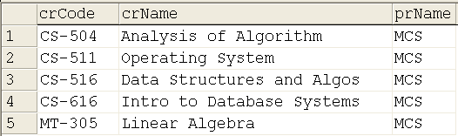

Slide 6
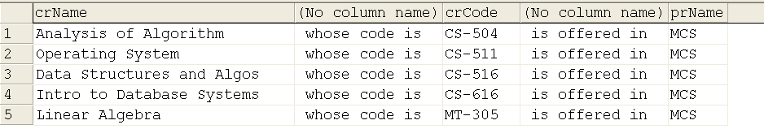

Slide 7
Not Operator
Inverses the predicate’s value
Q: List the course names offered to programs other than MCS
SELECT crCode, crName, prName
FROM course
WHERE not (prName = ‘MCS’)

Slide 8
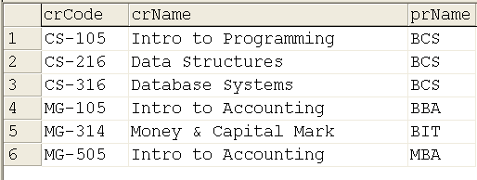

Slide 9
SELECT crCode, crName, prName
FROM course
WHERE (prName != ‘MCS’)

Slide 10
The BETWEEN Operator
Checks the value in a range
Q: List the IDs of the students with course codes having marks between 70 and 80
SELECT stId, crCode, totMrks
From ENROLL
WHERE totMrks between 70 and 80

Slide 11
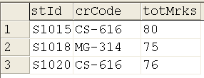

Slide 12
The IN Operator
Checks in a list of values
Q: Give the course names of MCS and BCS programs
SELECT crName, prName
From course
Where prName in (‘MCS’, ‘BCS’)

Slide 13
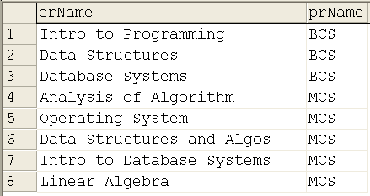

Slide 14
SELECT crName, prName
From course
Where (prName = ‘MCS’) OR (prName = ‘BCS’)

Slide 15
Like Operator
Q: Display the names and credits of CS programs
SELECT crName, crCrdts, prName FROM course
WHERE prName like '%CS'

Slide 16
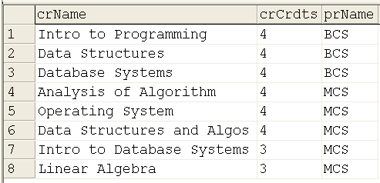

Slide 17
“Order By” Clause
Sorts the rows in a particular order
SELECT select_list
FROM table_source
[ WHERE search_condition ]
[ ORDER BY order_expression [ ASC | DESC ]
[,……n]
]

Slide 18
Database
Management System
Lecture - 29

